Slide 1
Discrete Mathematics and Its Application 7th edition, 2001
Kenneth H. Rosen

Slide 2
Welcome to Discrete Mathematics Spring 2018
Instructor: Niu Shao Zhang

Slide 3
§4.6 Cryptography
Section Summary
Classical Cryptography
Cryptosystems
Public Key Cryptography
RSA Cryptosystem
Crytographic Protocols
Primitive Roots and Discrete Logarithms

Slide 4
Caesar Cipher
Here is how the encryption process works:
Replace each letter by an integer from Z₂₆, that is an integer from 0 to 25 representing one less than its position in the alphabet.
The encryption function is f(p) = (p + 3) mod 26. It replaces each integer p in the set {0,1,2,…,25} by f(p) in the set {0,1,2,…,25} .
A | B | C | D | E | F | G | H | I | J | K | L | M | N | O | P | Q | R | S | T | U | V | W | X | Y | Z
0 | 1 | 2 | 3 | 4 | 5 | 6 | 7 | 8 | 9 | 10 | 11 | 12 | 13 | 14 | 15 | 16 | 17 | 18 | 19 | 20 | 21 | 22 | 23 | 24 | 25
X | Y | Z | A | B | C | D | E | F | G | H | I | J | K | L | M | N | O | P | Q | R | S | T | U | V | W
0 | 1 | 2 | 3 | 4 | 5 | 6 | 7 | 8 | 9 | 10 | 11 | 12 | 13 | 14 | 15 | 16 | 17 | 18 | 19 | 20 | 21 | 22 | 23 | 24 | 25

Slide 5
Example: Encrypt the message “MEET YOU IN THE PARK” using the Caesar cipher.
Solution:
M E E T Y O U I N T H E P A R K
12 4 4 19 24 14 20 8 13 19 7 4 15 0 17 10.
Now replace each of these numbers p by f(p) = (p + 3) mod 26.
15 7 7 22 1 17 23 11 16 22 10 7 18 3 20 13.
P H H W B R X L Q W K H S D U N
The encrypted message
“PHHW BRX LQ WKH SDUN.”
A | B | C | D | E | F | G | H | I | J | K | L | M | N | O | P | Q | R | S | T | U | V | W | X | Y | Z
0 | 1 | 2 | 3 | 4 | 5 | 6 | 7 | 8 | 9 | 10 | 11 | 12 | 13 | 14 | 15 | 16 | 17 | 18 | 19 | 20 | 21 | 22 | 23 | 24 | 25

Slide 6
Caesar Cipher
A | B | C | D | E | F | G | H | I | J | K | L | M | N | O | P | Q | R | S | T | U | V | W | X | Y | Z
0 | 1 | 2 | 3 | 4 | 5 | 6 | 7 | 8 | 9 | 10 | 11 | 12 | 13 | 14 | 15 | 16 | 17 | 18 | 19 | 20 | 21 | 22 | 23 | 24 | 25
Example 2: Decrypt the message “LEWLYPLUJL PZ H NYLHA ALHJOLY” that was encrypted using the Caesar Cipher with k = 7.
Solution: Replace each letter with the corresponding element of Z₂₆.
11 4 22 11 24 15 11 20 9 11 15 25 7 13 24 11 7 0 0 11 7 9 14 11 24.
Shift each of the numbers by −k = −7 modulo 26, yielding
4 23 15 4 17 8 4 13 2 4 8 18 0 6 17 4 0 19 19 4 0 2 7 4 17.
Translating the numbers back to letters produces the decrypted message
“EXPERIENCE IS A GREAT TEACHER.”

Slide 7
Shift Cipher
Caesar Cipher is Shift Cipher
Example 1: Encrypt the message “STOP GLOBAL WARMING” using the shift cipher with k = 11.
Solution: Replace each letter with the corresponding element of Z₂₆.
18 19 14 15 6 11 14 1 0 11 22 0 17 12 8 13 6.
Apply the shift f(p) = (p + 11) mod 26, yielding
3 4 25 0 17 22 25 12 11 22 7 11 2 23 19 24 17.
Translating the numbers back to letters produces the ciphertext
“DEZA RWZMLW HLCXTYR.”

Slide 8
Affine Ciphers（仿射密码）
Shift ciphers are a special case of affine ciphers which use functions of the form
f(p) = (ap + b) mod 26,
where a and b are integers, chosen so that f is a bijection.
The function is a bijection if and only if gcd(a,26) = 1.
Example: What letter replaces the letter K when the function f(p) = (7p + 3) mod 26 is used for encryption.
Solution: Since 10 represents K, f(10) = (7∙10 + 3) mod 26 =21, which is then replaced by V.
To decrypt a message encrypted by a shift cipher, the congruence c ≡ ap + b (mod 26) needs to be solved for p.
Subtract b from both sides to obtain c− b ≡ ap (mod 26).
Multiply both sides by the inverse of a modulo 26, which exists since gcd(a,26) = 1.
ā(c− b) ≡ āap (mod 26), which simplifies to ā(c− b) ≡ p (mod 26).
p ≡ ā(c− b) (mod 26) is used to determine p in Z₂₆.

Slide 9
Cryptanalysis of Affine Ciphers
The process of recovering plaintext from ciphertext without knowledge both of the encryption method and the key is known as cryptanalysis or breaking codes.
An important tool for cryptanalyzing ciphertext produced with a affine ciphers is the relative frequencies of letters. The nine most common letters in the English texts are E 13%, T 9%, A 8%, O 8%, I 7%, N 7%, S 7%, H 6%, and R 6%.
To analyze ciphertext:
Find the frequency of the letters in the ciphertext.
Hypothesize that the most frequent letter is produced by encrypting E.
If the value of the shift from E to the most frequent letter is k, shift the ciphertext by −k and see if it makes sense.
If not, try T as a hypothesis and continue.

Slide 10
Cryptanalysis of Affine Ciphers
Example: We intercepted the message “ZNK KGXRE HOXJ MKZY ZNK CUXS” that we know was produced by a shift cipher. Let’s try to cryptanalyze.
Solution: The most common letter in the ciphertext is K. So perhaps the letters were shifted by 6 since this would then map E to K. Shifting the entire message by −6 gives us “THE EARLY BIRD GETS THE WORM.”
6
A | B | C | D | E | F | G | H | I | J | K | L | M | N | O | P | Q | R | S | T | U | V | W | X | Y | Z
0 | 1 | 2 | 3 | 4 | 5 | 6 | 7 | 8 | 9 | 10 | 11 | 12 | 13 | 14 | 15 | 16 | 17 | 18 | 19 | 20 | 21 | 22 | 23 | 24 | 25

Slide 11
Block Ciphers（分组密码）
Ciphers that replace each letter of the alphabet by another letter are called character or monoalphabetic ciphers.
They are vulnerable to cryptanalysis based on letter frequency. Block ciphers avoid this problem, by replacing blocks of letters with other blocks of letters.
A simple type of block cipher is called the transposition cipher. The key is a permutation σ of the set {1,2,…,m}, where m is an integer, that is a one-to-one function from {1,2,…,m} to itself.
To encrypt a message, split the letters into blocks of size m, adding additional letters to fill out the final block. We encrypt p₁,p₂,…,p_{m} as c₁,c₂,…,c_{m} = p_{σ(1)},p_{σ(2)},…,p_{σ(m)}.
To decrypt the c₁,c₂,…,c_{m} transpose the letters using the inverse permutation σ⁻¹.

Slide 12
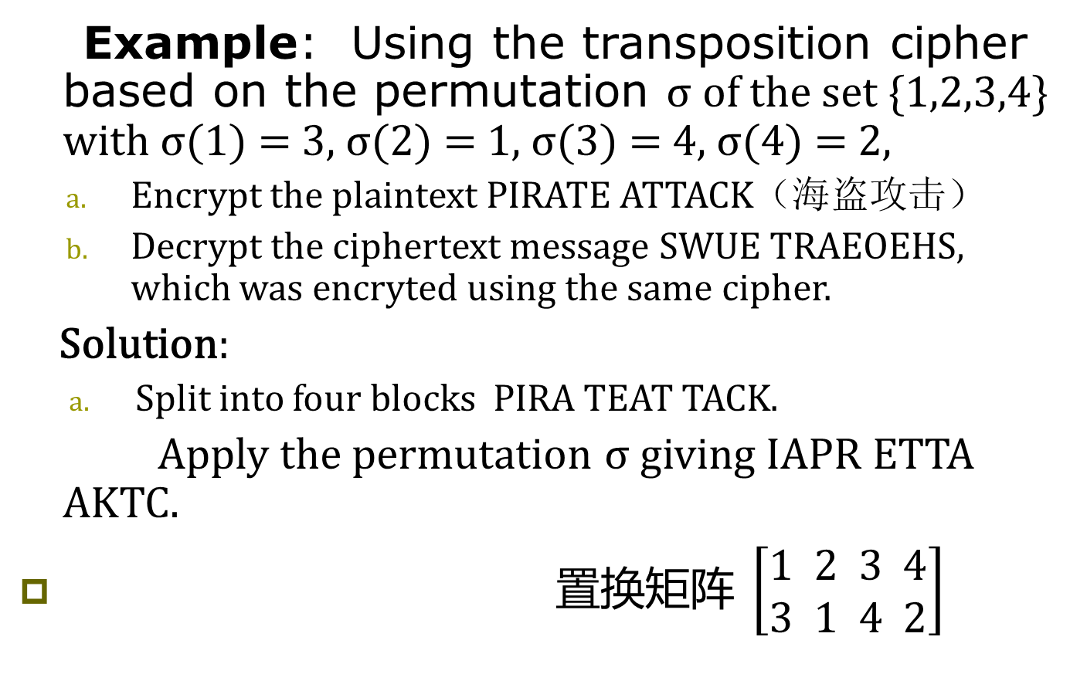
Block Ciphers
Example: Using the transposition cipher based on the permutation σ of the set {1,2,3,4} with σ(1) = 3, σ(2) = 1, σ(3) = 4, σ(4) = 2,
Encrypt the plaintext PIRATE ATTACK（海盗攻击）
Decrypt the ciphertext message SWUE TRAEOEHS, which was encryted using the same cipher.
Solution:
Split into four blocks PIRA TEAT TACK.
Apply the permutation σ giving IAPR ETTA AKTC.
置换矩阵 $\left[\begin{matrix}1 \\ 3\end{matrix} \begin{matrix}2 \\ 1\end{matrix} \begin{matrix}3 \\ 4\end{matrix} \begin{matrix}4 \\ 2\end{matrix}\right]$

Slide 13
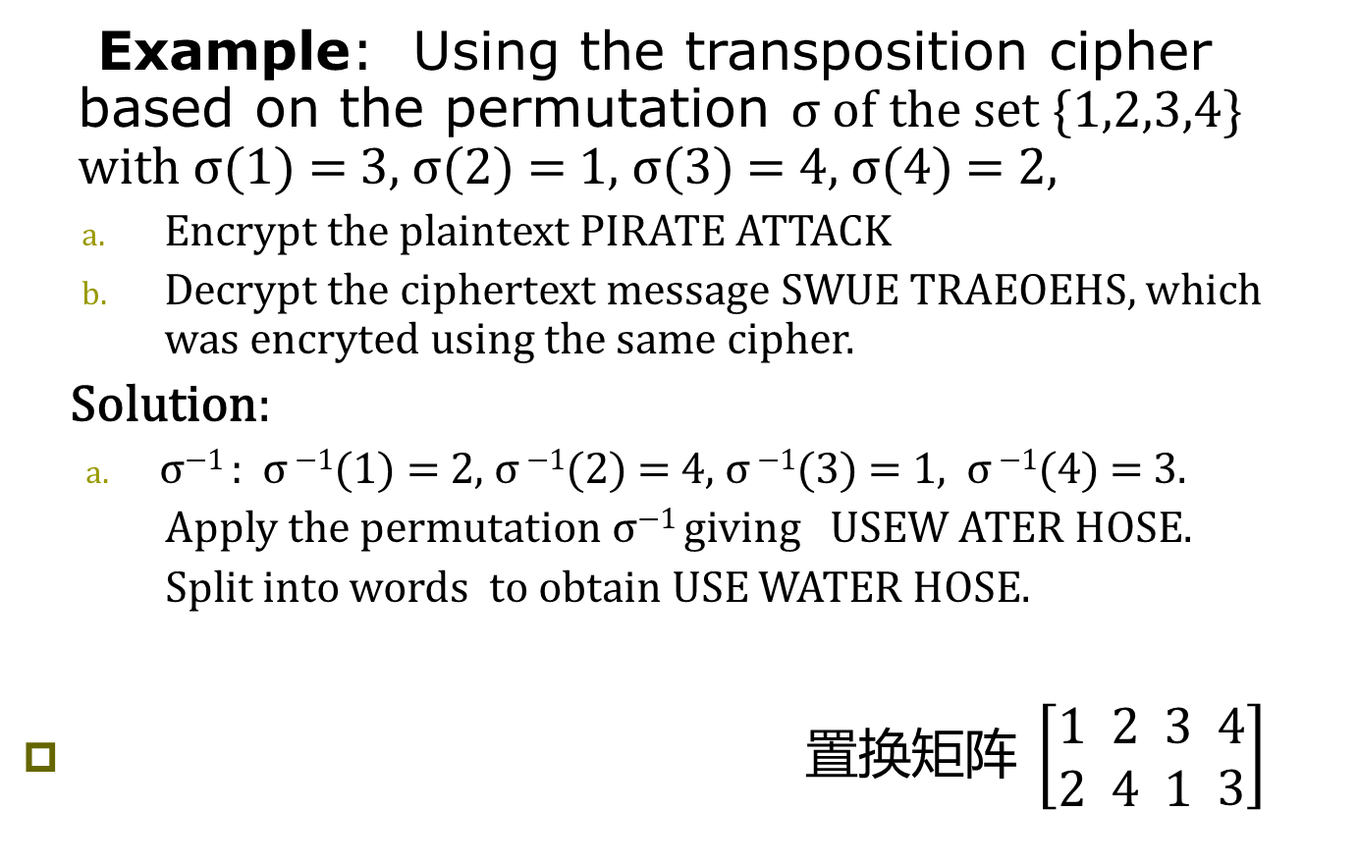
Block Ciphers
Example: Using the transposition cipher based on the permutation σ of the set {1,2,3,4} with σ(1) = 3, σ(2) = 1, σ(3) = 4, σ(4) = 2,
Encrypt the plaintext PIRATE ATTACK
Decrypt the ciphertext message SWUE TRAEOEHS, which was encryted using the same cipher.
Solution:
σ⁻¹ : σ ⁻¹(1) = 2, σ ⁻¹(2) = 4, σ ⁻¹(3) = 1, σ ⁻¹(4) = 3.
Apply the permutation σ⁻¹ giving USEW ATER HOSE.
Split into words to obtain USE WATER HOSE.
置换矩阵 $\left[\begin{matrix}1 \\ 2\end{matrix} \begin{matrix}2 \\ 4\end{matrix} \begin{matrix}3 \\ 1\end{matrix} \begin{matrix}4 \\ 3\end{matrix}\right]$

Slide 14
Cryptosystems
Definition: A cryptosystem is a five-tuple (P,C,K,E,D), where
P is the set of plainntext strings,
C is the set of ciphertext strings,
K is the keyspace (set of all possible keys),
E is the set of encription functions, and
D is the set of decryption functions.
The encryption function in E corresponding to the key k is denoted by E_{k} and the decription function in D that decrypts cipher text enrypted using E_{k} is denoted by D_{k}. Therefore:
D_{k}(E_{k}(p)) = p,
for all plaintext strings p.

Slide 15
Cryptosystems
Example: Describe the family of shift ciphers as a cryptosystem.
Solution: Assume the messages are strings consisting of elements in Z₂₆.
P is the set of strings of elements in Z₂₆,
C is the set of strings of elements in Z₂₆,
K = Z₂₆,
E consists of functions of the form E_{k} (p) = (p + k) mod 26 , and
D is the same as E where D_{k} (p) = (p − k) mod 26 .

Slide 16
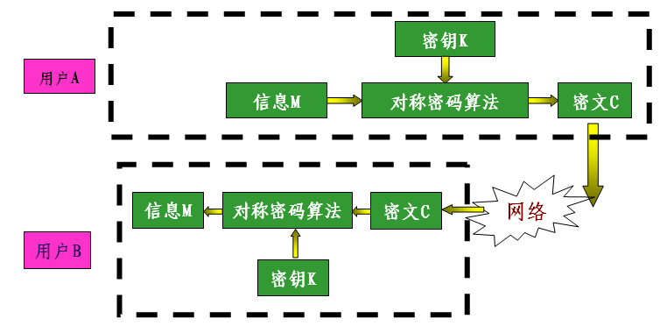
对称加密示意图

Slide 17
单钥加密体制
算法
DES
IDEA
AES
相同密钥
密钥如何传递?
发方
收方
方案
&#
&#
方案
明文
密文
密文
明文

Slide 18
Public Key Cryptography
All classical ciphers, including shift and affine ciphers, are private key cryptosystems. Knowing the encryption key allows one to quickly determine the decryption key.
All parties who wish to communicate using a private key cryptosystem must share the key and keep it a secret.
In public key cryptosystems, first invented in the 1970s, knowing how to encrypt a message does not help one to decrypt the message. Therefore, everyone can have a publicly known encryption key. The only key that needs to be kept secret is the decryption key.

Slide 19
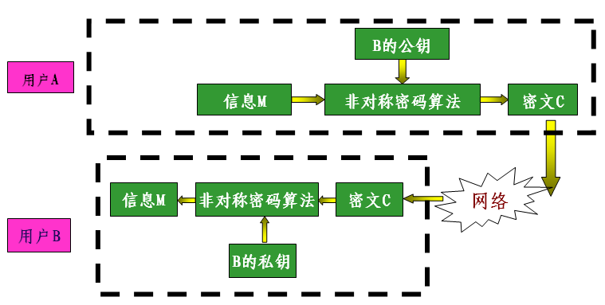
非对称加密示意图

Slide 20


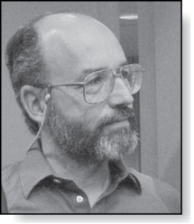
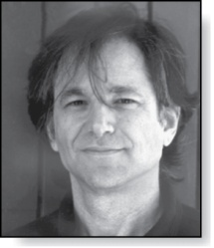
The RSA Cryptosystem
Clifford Cocks
(Born 1950)
A public key cryptosystem, now known as the RSA system was introduced in 1976 by three researchers at MIT.
It is now known that the method was discovered earlier by Clifford Cocks, working secretly for the UK government.
The public encryption key is (n,e), where n = pq (the modulus) is the product of two large (200 digits) primes p and q, and an exponent e that is relatively prime to (p−1)(q −1). The two large primes can be quickly found using probabilistic primality tests, discussed earlier. But n = pq, with approximately 400 digits, cannot be factored in a reasonable length of time.
Adi Shamir
(Born 1952)
Leonard
Adelman
(Born 1945)
Ronald Rivest
(Born 1948)

Slide 21
RSA Encryption
To encrypt a message using RSA using a key (n,e) :
Translate the plaintext message M into sequences of two digit integers representing the letters. Use 00 for A, 01 for B, etc.
Concatenate the two digit integers into strings of digits.
Divide this string into equally sized blocks of 2N digits where 2N is the largest even number 2525…25 with 2N digits that does not exceed n.
The plaintext message M is now a sequence of integers m₁,m₂,…,m_{k}.
Each block (an integer) is encrypted using the function C = Me mod n.
Example: Encrypt the message STOP using the RSA cryptosystem with key(2537,13). （公钥）
2537 = 43∙ 59,
p = 43 and q = 59 are primes and gcd(e,(p−1)(q −1)) = gcd(13, 42∙ 58) = 1.
Solution: Translate the letters in STOP to their numerical equivalents 18 19 14 15.
Divide into blocks of four to obtain 1819 1415.
Encrypt each block using the mapping C = M¹³ mod 2537.
Since 1819¹³ mod 2537 = 2081 and 1415¹³ mod 2537 = 2182, the encrypted message is 2081 2182.
A | B | C | D | E | F | G | H | I | J | K | L | M | N | O | P | Q | R | S | T | U | V | W | X | Y | Z
00 | 01 | 02 | 03 | 04 | 05 | 06 | 07 | 08 | 09 | 10 | 11 | 12 | 13 | 14 | 15 | 16 | 17 | 18 | 19 | 20 | 21 | 22 | 23 | 24 | 25

Slide 22
RSA Decryption
To decrypt a RSA ciphertext message, the decryption key d, an inverse of e modulo (p−1)(q −1) is needed. The inverse exists since gcd(e,(p−1)(q −1)) = gcd(13, 42∙ 58) = 1.
With the decryption key d, we can decrypt each block with the computation M = C^{d} mod p∙q. (see text for full derivation)
RSA works as a public key system since the only known method of finding d is based on a factorization of n into primes. There is currently no known feasible method for factoring large numbers into primes.
Example: The message 0981 0461 is received. What is the decrypted message if it was encrypted using the RSA cipher from the previous example.
Solution: The message was encrypted with n = 43∙ 59 and exponent 13. An inverse of 13 modulo 42∙ 58 = 2436 (exercise 2 in Section 4.4) is d = 937.
To decrypt a block C, M = C⁹³⁷ mod 2537.
Since 0981⁹³⁷ mod 2537 = 0704 and 0461⁹³⁷ mod 2537 = 1115, the decrypted message is 0704 1115. Translating back to English letters, the message is HELP.
A | B | C | D | E | F | G | H | I | J | K | L | M | N | O | P | Q | R | S | T | U | V | W | X | Y | Z
00 | 01 | 02 | 03 | 04 | 05 | 06 | 07 | 08 | 09 | 10 | 11 | 12 | 13 | 14 | 15 | 16 | 17 | 18 | 19 | 20 | 21 | 22 | 23 | 24 | 25

Slide 23
双钥加密体制
认证中心
公钥（证书）
私钥（智能卡）
代表算法
RSA
椭圆曲线
加密密钥
解密密钥
发方
收方
方案
&#
&#
方案
明文
密文
密文
明文

Slide 24
Cryptographic Protocols: Key Exchange
Cryptographic protocols are exchanges of messages carried out by two or more parties to achieve a particular security goal.
Key exchange is a protocol by which two parties can exchange a secret key over an insecure channel without having any past shared secret information. Here the Diffe-Hellman key agreement protcol is described by example.
Suppose that Alice and Bob want to share a common key.
Alice and Bob agree to use a prime p and a primitive root a of p.
Alice chooses a secret integer k₁ and sends a^{k1} mod p to Bob.
Bob chooses a secret integer k₂ and sends a^{k2} mod p to Alice.
Alice computes (a^{k2})^{k1} mod p.
Bob computes (a^{k1})^{k2} mod p.
At the end of the protocol, Alice and Bob have their shared key
(a^{k2})^{k1} mod p = (a^{k1})^{k2} mod p.
To find the secret information from the public information would require the adversary to find k₁ and k₂ from a^{k1} mod p and a^{k2} mod p respectively. This is an instance of the discrete logarithm problem, considered to be computationally infeasible when p and a are sufficiently large.

Slide 25
Cryptographic Protocols: Digital Signatures
Adding a digital signature to a message is a way of ensuring the recipient that the message came from the purported sender.
Suppose that Alice’s RSA public key is (n,e) and her private key is d. Alice encrypts a plain text message x using E_{(n,e)} (x)= x^{d} mod n. She decrypts a ciphertext message y using D_{(n,e)} (y)= y^{d} mod n.
Alice wants to send a message M so that everyone who receives the message knows that it came from her.
She translates the message to numerical equivalents and splits into blocks, just as in RSA encryption.
She then applies her decryption function D_{(n,e)} to the blocks and sends the results to all intended recipients.
The recipients apply Alice’s encryption function and the result is the original plain text since E_{(n,e)} (D_{(n,e)} (x))= x.
Everyone who receives the message can then be certain that it came from Alice.

Slide 26
Cryptographic Protocols: Digital Signatures
Example: Suppose Alice’s RSA cryptosystem is the same as in the earlier example with key(2537,13), 2537 = 43∙ 59, p = 43 and q = 59 are primes and gcd(e,(p−1)(q −1)) = gcd(13, 42∙ 58) = 1.
Her decryption key is d = 937.
She wants to send the message “MEET AT NOON” to her friends so that they can be certain that the message is from her.
Solution: Alice translates the message into blocks of digits 1204 0419 0019 1314 1413.
She then applies her decryption transformation D_{(2537,13)} (x)= x⁹³⁷ mod 2537 to each block.
She finds (using her laptop, programming skills, and knowledge of discrete mathematics) that 1204⁹³⁷ mod 2537 = 817, 419⁹³⁷ mod 2537 = 555 , 19⁹³⁷ mod 2537 = 1310, 1314⁹³⁷ mod 2537 = 2173, and 1413⁹³⁷ mod 2537 = 1026.
She sends 0817 0555 1310 2173 1026.
When one of her friends receive the message, they apply Alice’s encryption transformation E_{(2537,13)} to each block. They then obtain the original message which they translate back to English letters.

Slide 27
数字签名与验证过程示意图

